Slide 1
FLIGHT PRICE PREDICTION PROJECT
SUBMITTED BY:
ATISH KALANGUTKAR

Slide 2
CONTENTS
Introduction
Problem Statement
Problem Understanding
Benefits of Flight Price Prediction
Data Analysis & Model Building Flowchart
Exploratory Data Analysis (EDA)
Visualizations
Data Analysis Steps Done
Model Building
Hyper Parameter Tuning and Creating Final Model
Saving the model and prediction results
Conclusion

Slide 3
INTRODUCTION
The tourism industry is changing fast and this is attracting a lot more travelers each year. Airline industry is one of the most sophisticated industry in using complex pricing strategies to maximize revenue, based on proprietary algorithms and hidden variables. That is why the airline companies use complex algorithms to calculate the flight ticket prices. There are several different factors on which the price of the flight ticket depends. The seller has information about all the factors, but buyers are able to access limited information only, which is not enough to predict the airfare prices.
Now a days flight prices are quite unpredictable. The ticket prices change frequently. Customers seeking to get the lowest price for their ticket, while airline companies are trying to keep their overall revenue as high as possible. That’s why we will try to use machine learning models to solve this problem. This can help airlines by predicting what prices they can maintain and also it will help customers to predict future flight prices and plan their journey accordingly.

Slide 4
Problem Statement
Flight tickets prices is a thing which is very hard to guess, as today we might see a price of a particular flight and if we again went to check out the flight ticket prices of the same flight tomorrow than it will be different story this is because the airlines uses sophisticated quasi-academics tactics known as ‘revenue management’ or ‘yeild management’. So anyone who has booked ticket knows how unexpectedly the prices vary. The cheapest available ticket on a given flight gets more and less expensive over time. This usually happens as an attempt to maximize revenue based on:
Time of purchase patterns(making sure last minute purchases are expensive).
Keeping the flight as full as they want it(raising prices on a flight which is filling up in order to reduce sales and hold inventory for those expensive last minute expensive purchases).
Business Goal: The main aim of this project is to predict the price of flight tickets based on various features. The purpose of the paper is to study the factors which influence the fluctuations in the airfare prices and how they are related to the change in the prices.
Then using this information, build a system that can help buyers whether to buy a ticket or not. So, we will deploy an Machine Learning model for flight ticket price prediction and analysis. This model will provide the approximate selling price for the flight tickets based on different features.

Slide 5
Problem Understanding
Airlines implement dynamic pricing for their tickets, and base their pricing decisions on demand estimation models. The reason for such a complicated system is that each flight only has a set number of seats to sell, so airlines have to regulate demand. In the case where demand is expected to exceed capacity, the airline may increase prices, to decrease the rate at which seats fill. On the other hand, a seat that goes unsold represents a loss of revenue, and selling that seat for any price above the service cost for a single passenger would have been a more preferable scenario.
Here we are trying to help the buyers to understand the price of the flight tickets by deploying machine learning models. These models would help the sellers/buyers to understand the flight ticket prices in market and accordingly they would be able to book their tickets.
So here here we are trying to help the customers or buyers to understand the price of the flight tickets by deploying machine learning models. This models would help the sellers and buyers to understand the flight ticket prices in market and accordingly they will be able to book their tickets. This would be a practical implementation of a data analysis, statistics and machine learning techniques to solve a daily problem faces by travelers.

Slide 6
Benefits Of Flight Price Prediction
Pricing in the airline industry is often compared to a brain game between carriers and passengers where each party pursues the best rates. Carriers love selling tickets at the highest price possible while still not losing consumers to competitors. Passengers are crazy about buying flights at the lowest cost available while not missing the chance to get on board. All this makes flight prices fluctuant and hard to predict. But nothing is impossible for people armed with intellect and algorithms. Predicting flight prices helps an individuals to know and understand the future price of the flight tickets.
There are two main use cases of flight price prediction in the travel industry. OTAs and other travel platforms integrate this feature to attract more visitors looking for the best rates. Airlines employ the technology to forecast rates of competitors and adjust their pricing strategies accordingly.
A passenger-side predictor proposed by an OTA suggests the best time to buy a ticket so that travelers can make informed decisions. Carriers, on their end, try to find out the optimal price they should set to maximize revenue while remaining competitive.

Slide 7
Data Analysis And Model Building Flow Chart
Import Libraries
Import Collected Dataset
Data Preprocessing
Label Encoder
Visualizations
(EDA)
Feature Engineering
Identifying Outliers and Skewness
Checking Correlation
Model Building
Saving the Model & Predictions
Hyper Parameter Tuning
R2 score & Evaluation Metrics

Slide 8



Exploratory Data Analysis (EDA)
Importing required libraries and loading the dataset.
Checked some statistical information such as shape of the dataset,unique values and number of unique values present, type of data present in the columns,value counts, checked for duplicates etc.
Checked for null values but there were no null values present in the dataset.
Taking care of timestamp variables by converting data types of Date, Departure Time and Arrival Time from object data type into date time data types.
Done feature engineering on target variable that is ‘Price’ as it was having commas in between the numbers and because of that it was showing data type as object. So replaced them by empty spaces and converted the data type to integer.
The column duration was having values I terms of hours and minutes, so splitted the data into hours and minutes appended the data into new columns departure hours and departure minutes which was added to the dataset. And than ‘h’ and ‘m’ from columns departure hour and departure minute was replaced by empty spaces. After that their data type was converted from object to integer data type.
Than separated categorical and numeric features according to the data types.
Performed uni-variate, bi-variate and multi-variate analysis by plotting distribution plot, count plot, pie plot and bar plot.

Slide 9
Exploratory Data Analysis (EDA) Cont..
Than checked for the most expensive prices data, cheapest prices data and longest duration data.
Encoded the categorical features by using Label encoded method.
Checked whether there are any outliers present or not using box plot on numerical data columns and found that duration hours was having outliers so by using z-score method removed outliers.
Checked for skewness on numerical data columns and found that arrival hour and duration hours column was having skewness, so by using power transform method treated the skewness of that particular columns.
Used bar plot to check the correlation between the features and the label and after with the help of heatmap checked whether there is multicollinearity present or not among the features. So found that column departure_from and destination are highly multi correlated with each other. So plotting scatter plot to check the trend or relationship between them.
After plotting scatter plot we saw a positive relationship them, but to cross verify, i had used vif method, in that their values was showing infinity, so dropped both the columns and also month column was showing NaN value, so dropped that column also.
Separated feature and label data and than feature scaling was done by using power transform method to avoid any kind of data biasness.
After that feature selection method was used to select the best features for the prediction.

Slide 10
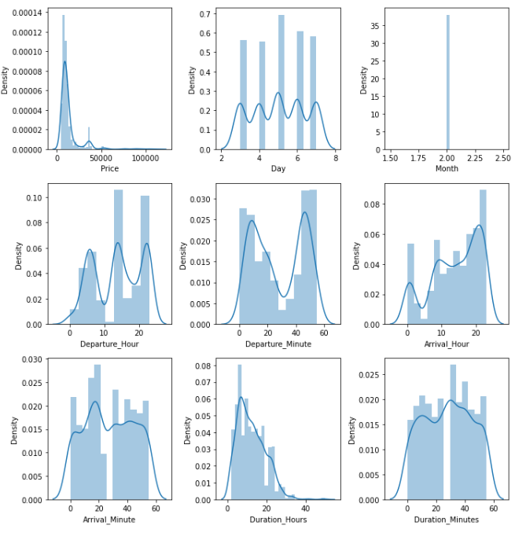
Visualization
By looking at the plots we can see that:
The distribution plot shows how the data has been distributed in each of the columns.
In column arrival hour and duration skewness is present and also data is not distributed normally as we don’t see a proper bell shaped curve.
So to cross verify this we will check the skewness and if the values is more than +5 or -5 than by using power transform method we will treat the skewness.
Distribution Plot

Slide 11
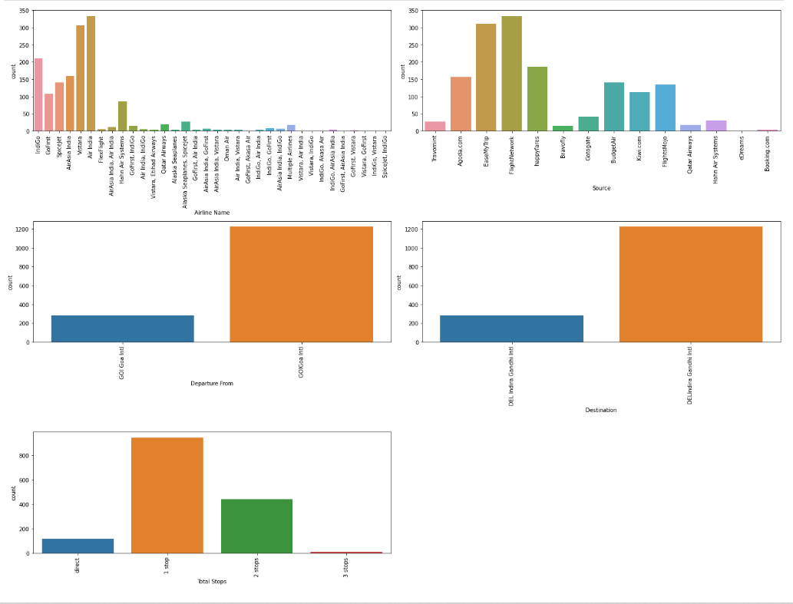
Visualization Cont..
The most of the flights which were travelling from Goa to Delhi from 3rd Feb to 7th Feb will be Air Asia amongst all the other airline companies.
Most of the prices which we have got from the source/site are from Flight Network.
All the flights departure is from Goa International Airport and arrival will be on Delhi Indira Gandhi Airport.
The data which we got from the date 3rd Feb to 7th Feb, in this most of the flights will be taking 1stop while travelling from Goa to Delhi.
Count Plots

Slide 12
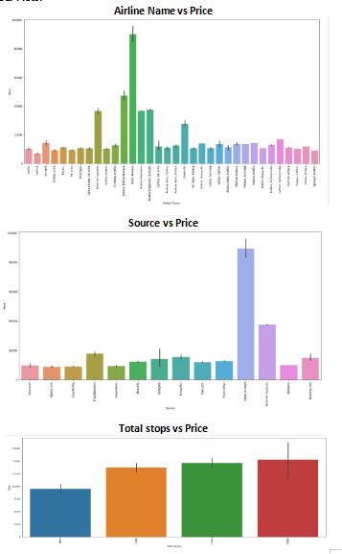
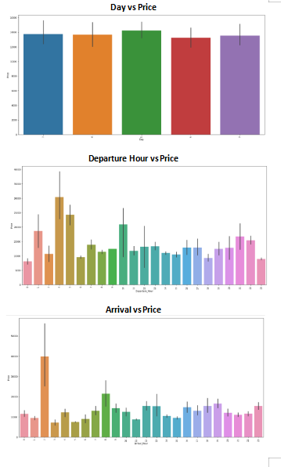
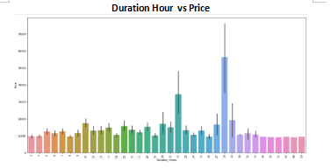
Visualization Cont..
In plot Airline Name vs Price we can see that Qatar airways have the highest prices for flight ticket which is more than 80000.
In plot Source vs Price we can see that source Qatar airways showing highest prices for flight ticket.
In plot Total Stops vs Price we can see that whenever there is a 3 stop in between while travelling from Goa to Delhi prices are higher as compared to others.
In plot Day vs Price we can see that on 5th Feb prices of flight tickets are higher than the other dates may be because of Sunday.
In plot Departure Hour vs Price we can see that early morning ticket prices are higher that is at 4am ticket prices are higher as compared to the other timings.
In plot Arrival Hour vs Price we can see that whenever the arrival hour is at 2am the ticket prices are higher as compared to others.
In plot Duration Hour vs Price we can see that the duration hours which is 28 hours have the highest ticket price.
Bar Plot

Slide 13
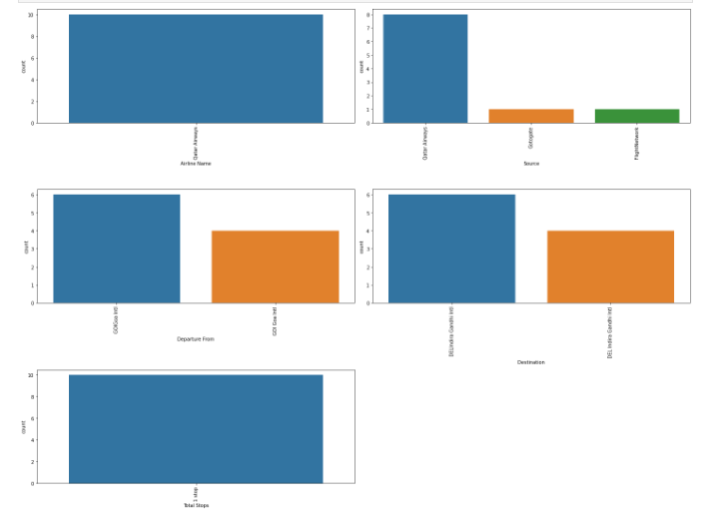
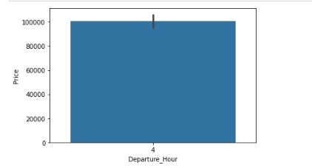
Visualization Cont..
By looking at the plots we can see that plots plotted from the data which have the highest 10 prices from date 3rd Feb to 7th Feb.
So in above plots we can see that Qatar airways have the most expensive flight tickets.
Again Qatar airways source have the highest of the flight tickets.
And while travelling all the Qatar airways took only 1 stop in between.
Bar Plot Highest 10
Highest Ticket Prices Count Plot(Highest 10)
So by looking at the bar plot we can see that whenever Qatar airways departure time was 4am that is in the early morning, the prices of the flight tickets was always expensive.

Slide 14
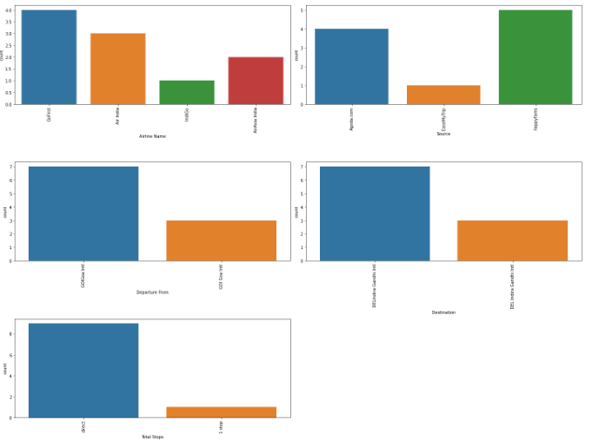
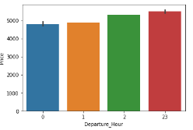
Visualization Cont..
By looking at the plots we can see the plots plotted from the data which have the lowest 10 prices from date 3rd feb to 7th feb.
So in above plots we can see that go first,Air India, Indigo and Air asia india have the cheapest flight tickets.
Agoda.com,Easemytrip and happyfares source have the lowest of the flight tickets.
And while travelling most of them did'nt take any stop inbetween.
Bar Plot Lowest 10
Cheapest Ticket Prices Count Plot(Lowest 10)
By looking at the bar plot we can see that when the flight departure timing was in the midnight or close to midnight that is at 12am, 1am, 2am and 11pm that time the prices of the flight tickets were cheapest.

Slide 15
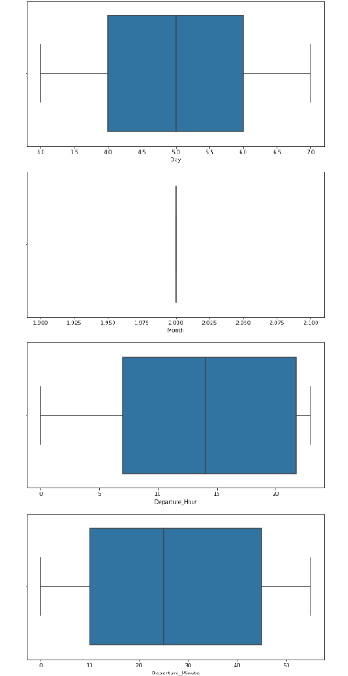
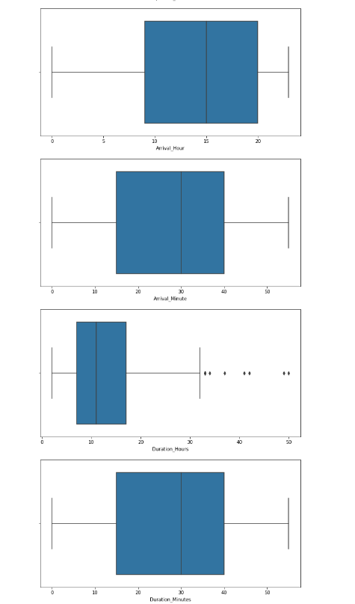
Identifying Outliers Using Box Plots
By looking at the box plots we can see that in column duration hours outliers are present, So by using z-score method it will be removed.

Slide 16
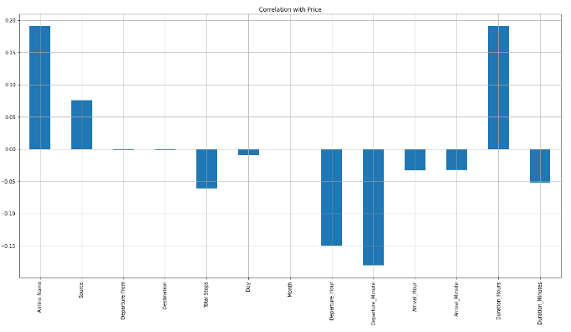
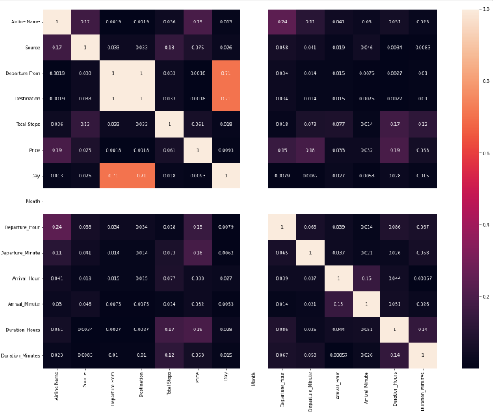
Correlation Between Features And Label
By looking at the bar plot we can see that features are positively as well as negatively correlated with the label.
By looking at the heatmap we can see if there is any multicollinearity problem between the Features.

Slide 17
Data Analysis Steps Done
Encoded the categorical column data by using Lable Encoder.
To visualize the correlation between the Features and Label and multicollinearity problem i have used bar plot and heatmap.
Used Box plot to check whether there are outliers present or not in continuous data columns. Further found that in one column outliers were present which were later on removed by using z-score method.
Skewness was checked and found that in two columns skewness was present so later on it was treated with the help of power transform method.
Used Standard Scaler method to standardize the data.
Split, Train and Test to build the machine learning model. Found best random state and accuracy.

Slide 18
Model Building
Since ‘Price’ is my target variable which is continuous in nature, so that we came to know that it is regression type problem.
After the pre-processing, data cleaning and feature selection method I left with 10 columns including target. The algorithms used on training the data are as follows:
1.Xtreme Gradient Boosting Regressor (XGB)
2.Gradient Boosting Regressor
3.Ada Boost Regressor
4.Random Forest Regressor

Slide 19
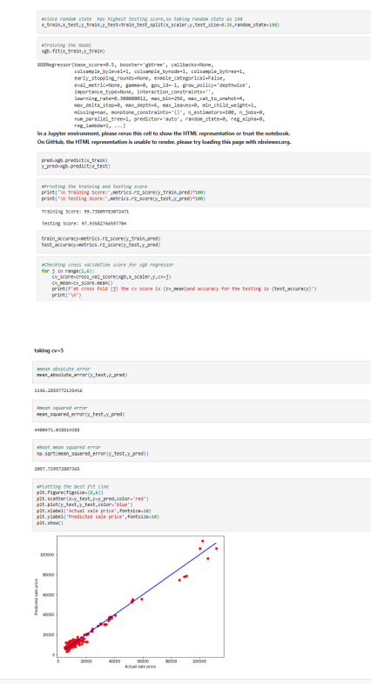
Xtreme Gradient Boosting Regressor
Created XGB Regressor model and checked for its evaluation metrics. The model is giving testing score as 97.93%.
From the graph we can observe how our model is mapping and also we can observe the straight line which is our actual dataset and dots are the predictions that the model has given.

Slide 20
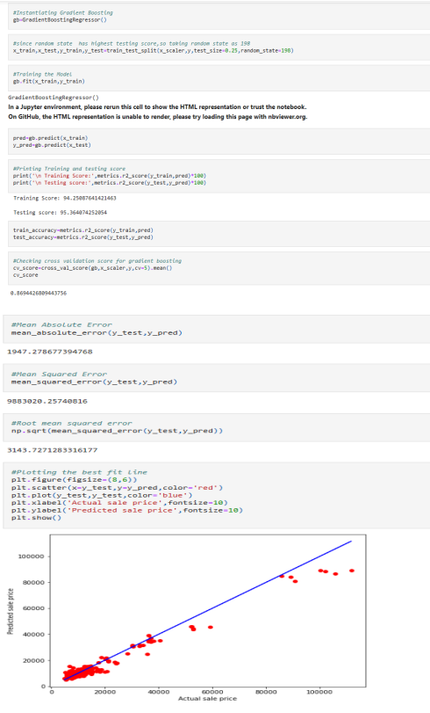
Gradient Boosting Regressor
Created Gradient Boosting Regressor model and checked for its evaluation metrics. The model is giving testing score as 95.36%.
From the graph we can observe how our model is mapping and also we can observe the straight line which is our actual dataset and dots are the predictions that the model has given.

Slide 21
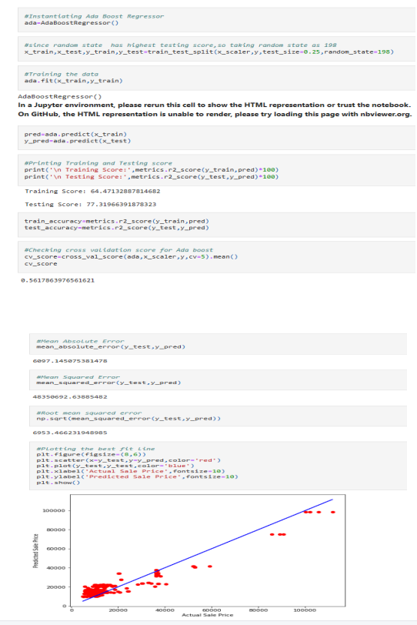
Ada Boost Regressor
Created Ada Boost Regressor model and checked for its evaluation metrics. The model is giving testing score as 77.31%.
From the graph we can observe how our model is mapping and also we can observe the straight line which is our actual dataset and dots are the predictions that the model has given.

Slide 22
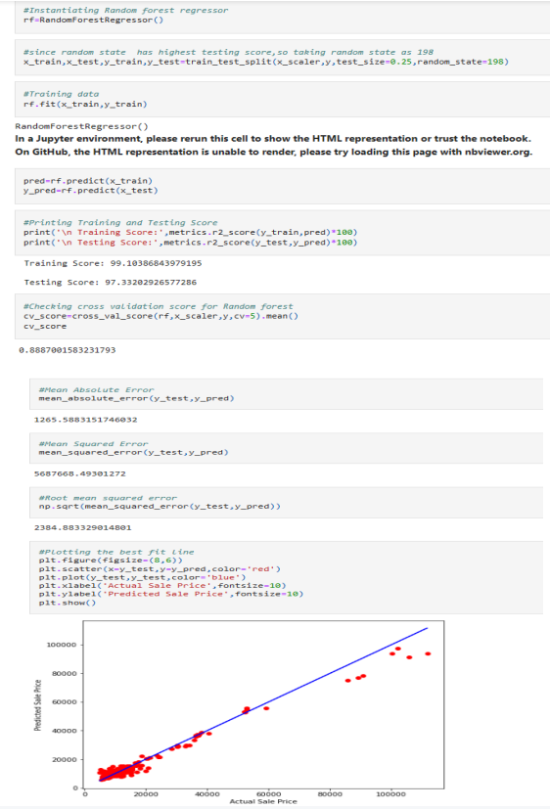
Random Forest Regressor
Created Ada Boost Regressor model and checked for its evaluation metrics. The model is giving testing score as 97.33%.
From the graph we can observe how our model is mapping and also we can observe the straight line which is our actual dataset and dots are the predictions that the model has given.

Slide 23
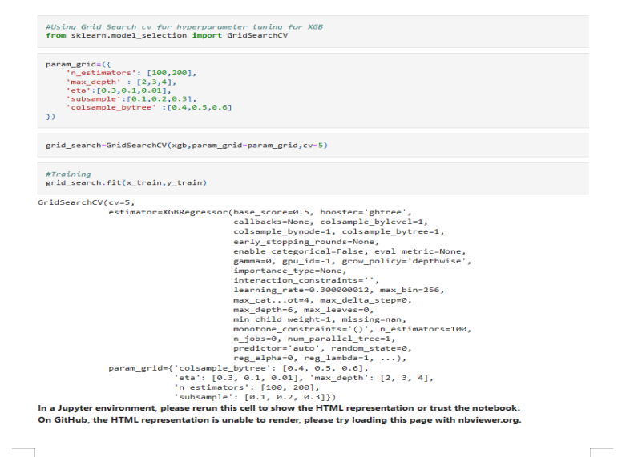
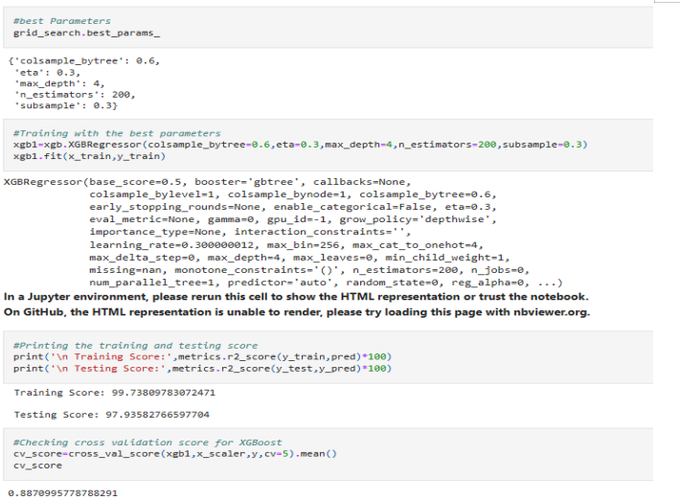
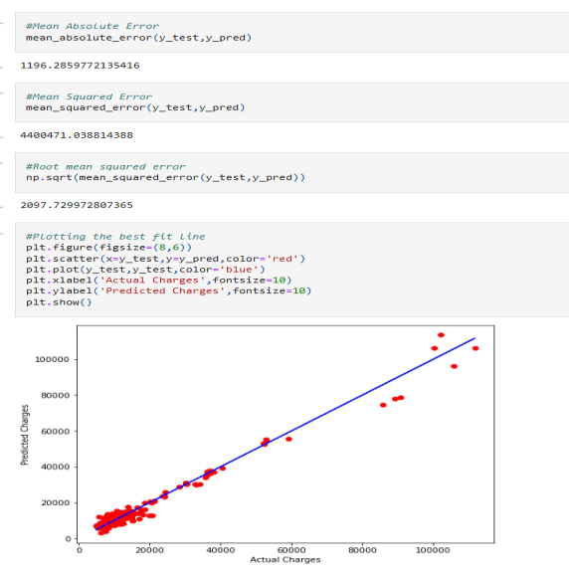
Hyperparameter Tuning And Creating Final Model
I have used Grid Search CV to tuned the model and get the best parameters of XGB Regressor. And after getting the best parameters used that for building final model to get the best accuracy.
After performing hyper parameter tuning using best parameters of XGB, the testing scores remained same but the cross validation score increased from 85% to 88% .
From the graph we can observe how our model is mapping and also we can observe the straight line which is our actual dataset and dots are the predictions that the model has given.

Slide 24
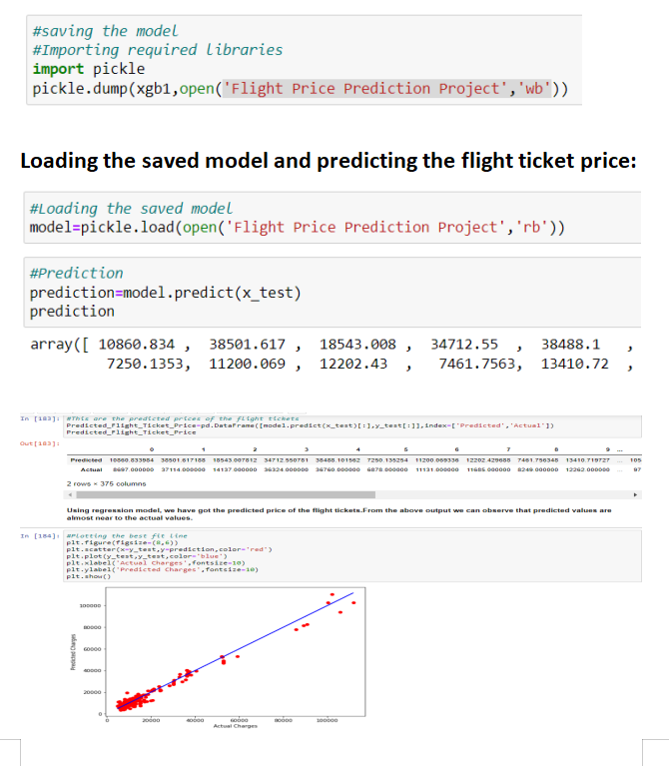
Saving The Model And Prediction From Saved Model
I have saved my final best model using pickle library and loaded saved model for predictions.
Using regression model, we have got the predicted price of the flight tickets. From the above output we can observe that predicted values are almost near to the actual values.
The graph shows how our model is mapping and the plot gives the linear relation between predicted and actual price of the flight tickets. The blue line is the best fitting line which gives us the actual values/data and red dots gives us the predicted values/data.

Slide 25
Conclusion
The case study aims to give an idea of applying machine learning algorithms to predict the price of the flight tickets. After the completion of this project, we got an insight of how to collect data, pre-processing the data, analyse the data, cleaning the data and building a model.
In this we have used 4 learning models to predict the price of the flight ticket.
From our detailed analysis we can determine the following:
Flight ticket prices change during the morning and evening time of the day.
Some flights more specifically Qatar Airways which are departing in the early morning that is at 4 AM are having most expensive ticket prices.
Some flights such as Go First, Air Asia, Indigo they have the cheapest ticket price especially in the late night or around mid night that is around 11 PM, 12 AM, 1AM like that.
From the analysis we came to know that late nights flights are cheaper compared to working hours.
The last minute flights are always expensive.
As in our data jet airways is not there, so I will compare between Indigo and Spice jet. So by looking at the plots we can see that Spice jet are slightly expensive than that of Indigo.
Morning flights as in early morning flights which departs at 4am are most expensive specifically the Qatar Airways.

Slide 26
THANK YOU！

